Slide 1

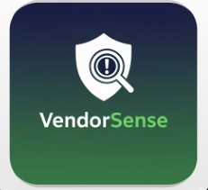

VendorSense
A Proactive LCNC Application for Vendor Contract Risk & Compliance Monitoring
Day 02: Final Submission: DecodingDataScience NoCode/LowCode Ai App Development Challenge (Nov ‘25)

Slide 2
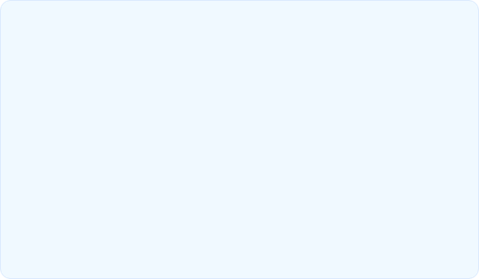
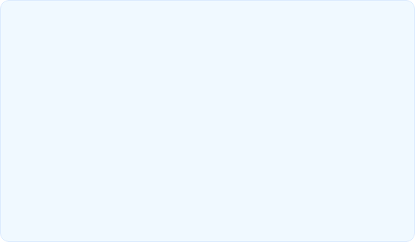
The Challenge & The Solution
The Problem
The Solution: VendorSense
Procurement & finance teams manually track hundreds of contracts, identifying risk only after failure. This reactive approach leads to predictable cost overruns, missed deadlines, and policy compliance breaches, wasting public funds and resources.
A Low-Code/No-Code (LCNC) dashboard built in Glide that provides real-time, automated risk scoring and compliance flagging. VendorSense turns reactive data into proactive, actionable insights for auditors and managers.

Slide 3






How It Works: The Logic Engine
1. Automated Risk Score
2. Proxy Compliance Flag
3. Relational Aggregation
Ranks all active contracts (High, Medium, Low) by analyzing real-time performance metrics:
• Cost Overrun %
• Reported Issues Count
• Days from Deadline
Automatically flags contracts for policy violations, focusing on high-risk areas:
• T&M Policy Violations
• Mandatory Clause Waivers
• (And more)
Uses relational logic to roll up individual contract risks to the vendor level, identifying which *vendors* pose the greatest threat to the portfolio (e.g., "Vendor A has 5 contracts, 3 are HIGH RISK").

Slide 4
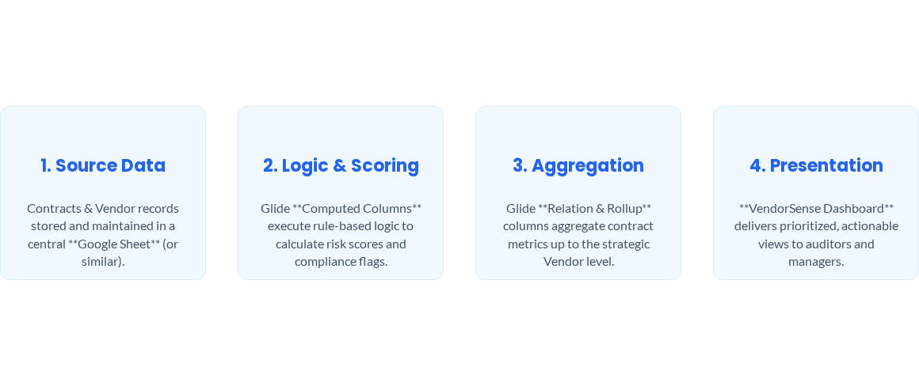
The VendorSense Data Pipeline

Slide 5
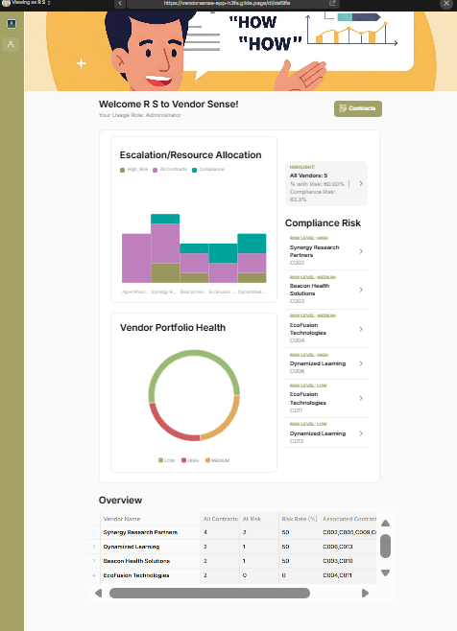
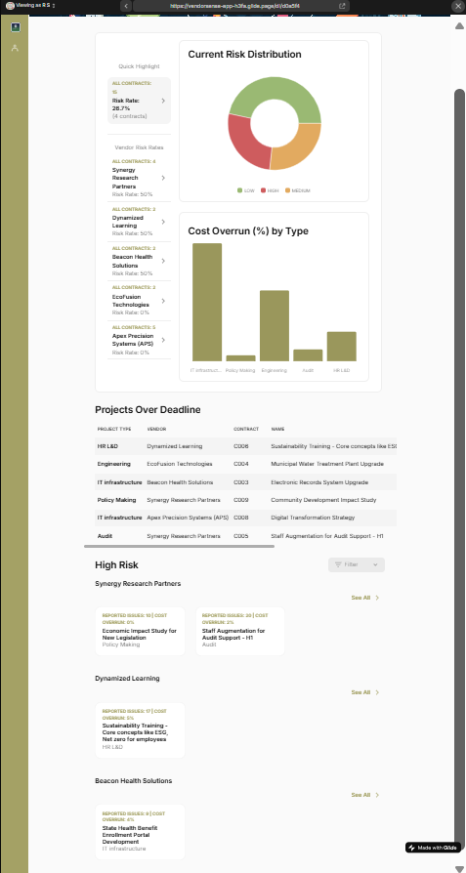
The Dual-View Dashboard
1. Strategic View (Vendor Health)
2. Operational View (Contracts List)

Slide 6
Project Impact & Key Outcomes
Rapid Value Delivery
Developed a functional MVP from concept to deployment in under 3 days using a Low-Code/No-Code platform (Glide).
Automated Rule-Based Logic
Successfully translated complex government financial policy and risk rules into an automated, zero-code logic engine.
Proactive Efficiency Gain
The app enables auditors to instantly filter and prioritize high-risk and non-compliant contracts, saving significant manual review time and resources.

Slide 7
Thank You
Ruchita Shah
(Ruchita Shah | LinkedIn || Ruchita Shah | Senior Data Specialist | Data portfolio)

